Slide 1


K.RAMAKRISHNAN COLLEGE OF TECHNOLOGY
(AUTONOMOUS), TRICHY.
DEPARTMENT OF
COMPUTER SCIENCE AND ENGINEERING
20CS5501 DESIGN PROJECT-1
Batch No. : 5
Date : 06.12.2024

Slide 2
CAMPUS RECRUITMENT SYSTEM
Guided by Team
Ms.V.Sowmiya ME., Narmadha N (811722104099)
Assistant Professor, CSE Kannagi G (811722104068)
Kiruthika R (811722104077)

Slide 3
OBJECTIVE OF THE PROJECT
The main objective of campus recruitment system is to identify and attract talented students who possess the necessary skills and potential to contribute to organizations.
It is to make easy of the recruitment process for organizations and students.

Slide 4
ABSTRACT
Online College Recruitment System:
Traditional college recruitment processes are often fragmented and inefficient, leading to delays, communication gaps, and challenges in managing a large volume of applications. The proposed system employs online application forms, and advanced analytics to optimize the workflow. It also features integration with CRM to ensure seamless data exchange and mobile accessibility for users. In proposed system HTML ,CSS, Javascript is used for frontend, PHP is used for Back-End and MYSQL is used for Database Software Stack: WAMP .The implementation of the college recruitment system leads to increased efficiency in managing applications and communications, improved recruitment outcomes through targeted strategies, and enhanced data-driven decision-making. Overall, it reduces administrative burdens, accelerates the recruitment process, and provides valuable insights for strategic planning.

Slide 5
LITERATURE SURVEY
TITLE OF THE PAPER | AUTHOR (S) | PUBLISHER | PAPER GIST | TECHNOLOGY USED
The Development of a Job Portal to Facilitate In campus Placement | Niaj Srivastava, Manashvi Tripathi, Vipin Rai | IEEE Xplore(2023) | The portal aims to increase accessibility, save time, and enhance the overall placement experience for all stakeholders | Web Development Frameworks, Database Management Systems, Data Analytics Tools, APIs and Cloud Computing
E-recruitment support system based on MOOCs | Lynda Haddadi, Mohammed EI Amine Tali, Farida Bouarab Dahmani, Tassadit Berkane | IEEE Xplore(2017) | The system matches candidate profiles with job requirements using detailed parsing of skills, education, and experience. | XML, JSON, Cloud storage
Research on Campus Recruitment management platform based on dynamic electronic commerce | Lu Shumin, Rao Yuan | IEEE Xplore(2010) | Automated candidate filtering based on predefined criteria, improving efficiency and reducing manual effort. | ReactJS, NodeJS and ExpressJS , MySQL.
Recruiting Young Engineers to the Pulp & Paper Industry - Perspectives from Recent Graduates | Jahan Kargar, Farah Qasemi | IEEE Pulp and Paper Industry Committee (PPIC).(2007) | It emphasizes the importance of providing real-world exposure through internships, mentorships, and industry conferences | Cloud Computing (AWS, Google Cloud), Java, HTML, CSS, MySQL.
Facilitating Job Recruitment Process Through Job Application Support | Junalux Chalidabhongse, Nattapon Jirapokakul , Rata Chutivisarn | Journal of Emerging Technologies and Innovative Research (JETIR).(2006) | It focuses on reducing the challenges faced in traditional recruitment by implementing systems like Applicant Tracking Systems (ATS), Candidate Relationship Management (CRM) | AI,ML,Virtual Reality (VR), Augmented Writing Platforms

Slide 6
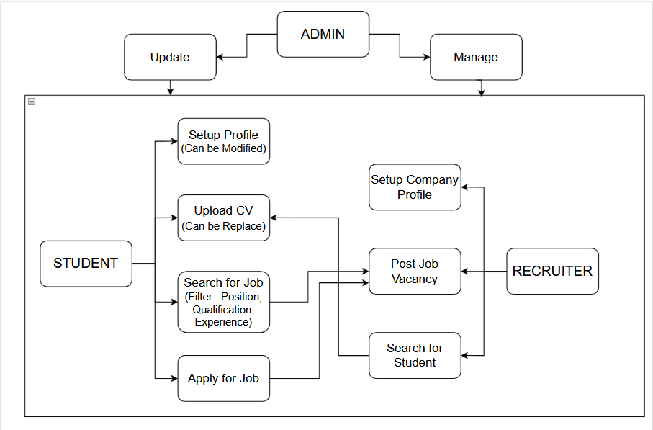
PROPOSED SYSTEM ARCHITECTURE

Slide 7
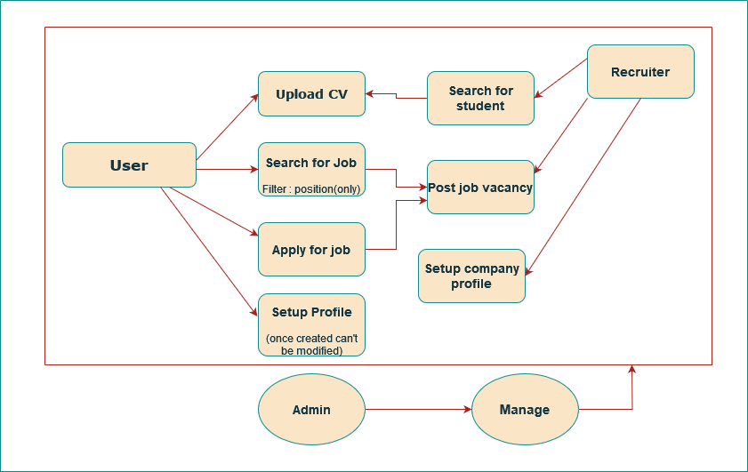
EXISTING SYSTEM ARCHITECTURE

Slide 8
SOFTWARE AND HARDWARE REQUIREMENTS
HARDWARE
SOFTWARE
Server Processor: Intel
XeonServer RAM: 16GB+
Server Storage: 500GB
SSDClient Processor: Intel i5/i7Client
RAM: 8GB+
Operating System: Linux/Windows
Server Backend: PHP
Frontend: HTML,CSS
Database: MySQL

Slide 9
MODULES
Admin Module
Student Module
Company Module

Slide 10
ADMIN MODULE
Summary: The Administrator Module gives administrators full control over the website. They can manage all users, including adding or removing accounts, update website content, and view company details. This module helps keep the platform running smoothly by allowing administrators to oversee and adjust various aspects of the site.
Key Features:
User Management: View, edit, or delete user accounts (jobseekers and companies).
Content Management: Update and change website pages and information.
Company Management: View and manage details of registered companies.
System Oversight: Monitor the platform’s performance and fix issues.

Slide 11
STUDENT MODULE
Summary: The Jobseeker Module allows individuals looking for jobs to register on the platform and manage their own profiles. After signing up, jobseekers can update their personal information and change their passwords
Key Features:
Registration and Login: Sign up and log into the platform.
Profile Management: Update personal information, work experience, and education.
Password Management: Change or reset passwords.
Job Search: Find and apply for job openings.

Slide 12
COMPANY MODULE
Summary: The Company Module lets businesses manage their profiles and job postings on the platform. Companies can create and manage job listings, review applications, and select candidates for hiring.
Key Features:
Registration and Login: Sign up and log into the platform.
Job Posting: Create and manage job listings.
Manage Candidates: Review applications, shortlist candidates, and make hiring decisions.

Slide 13
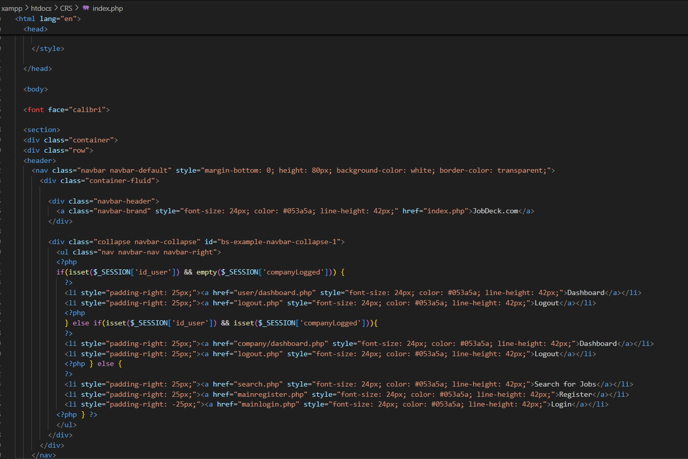
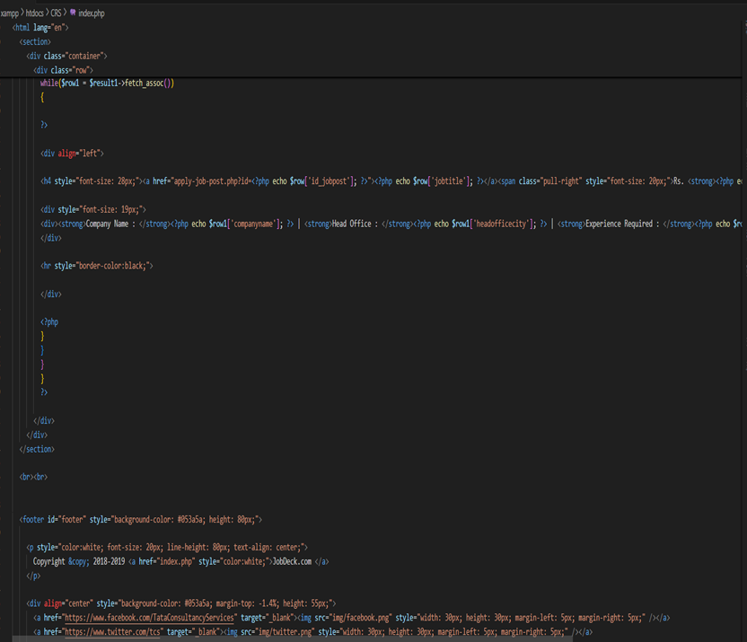
RESULTS AND DISCUSSION

Slide 14
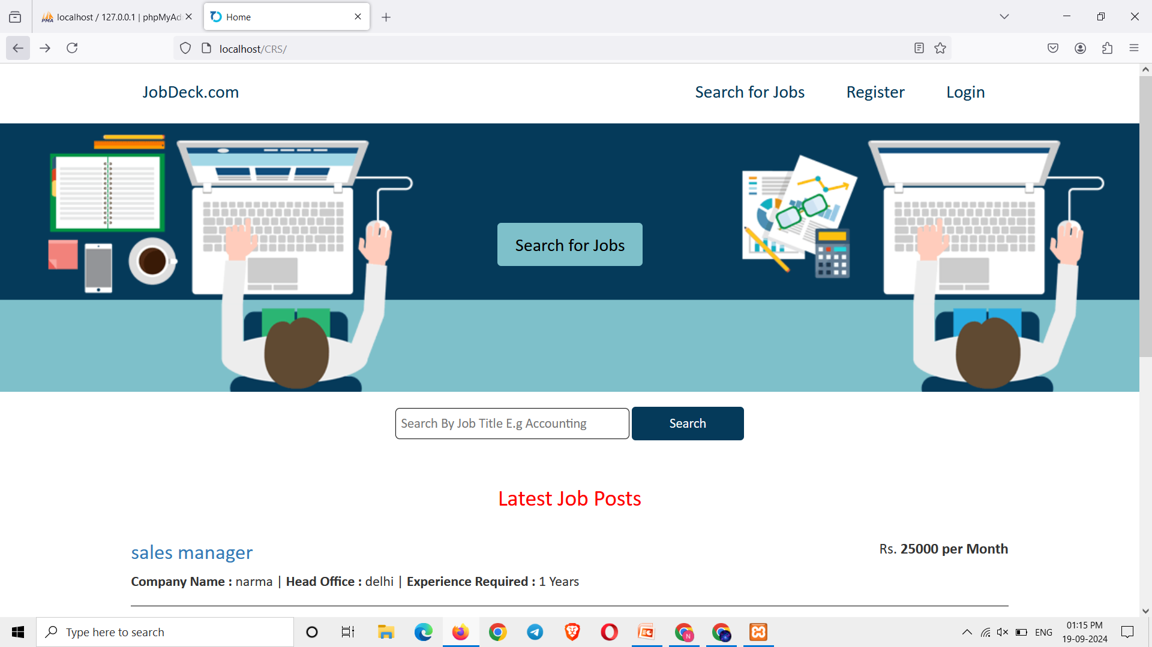
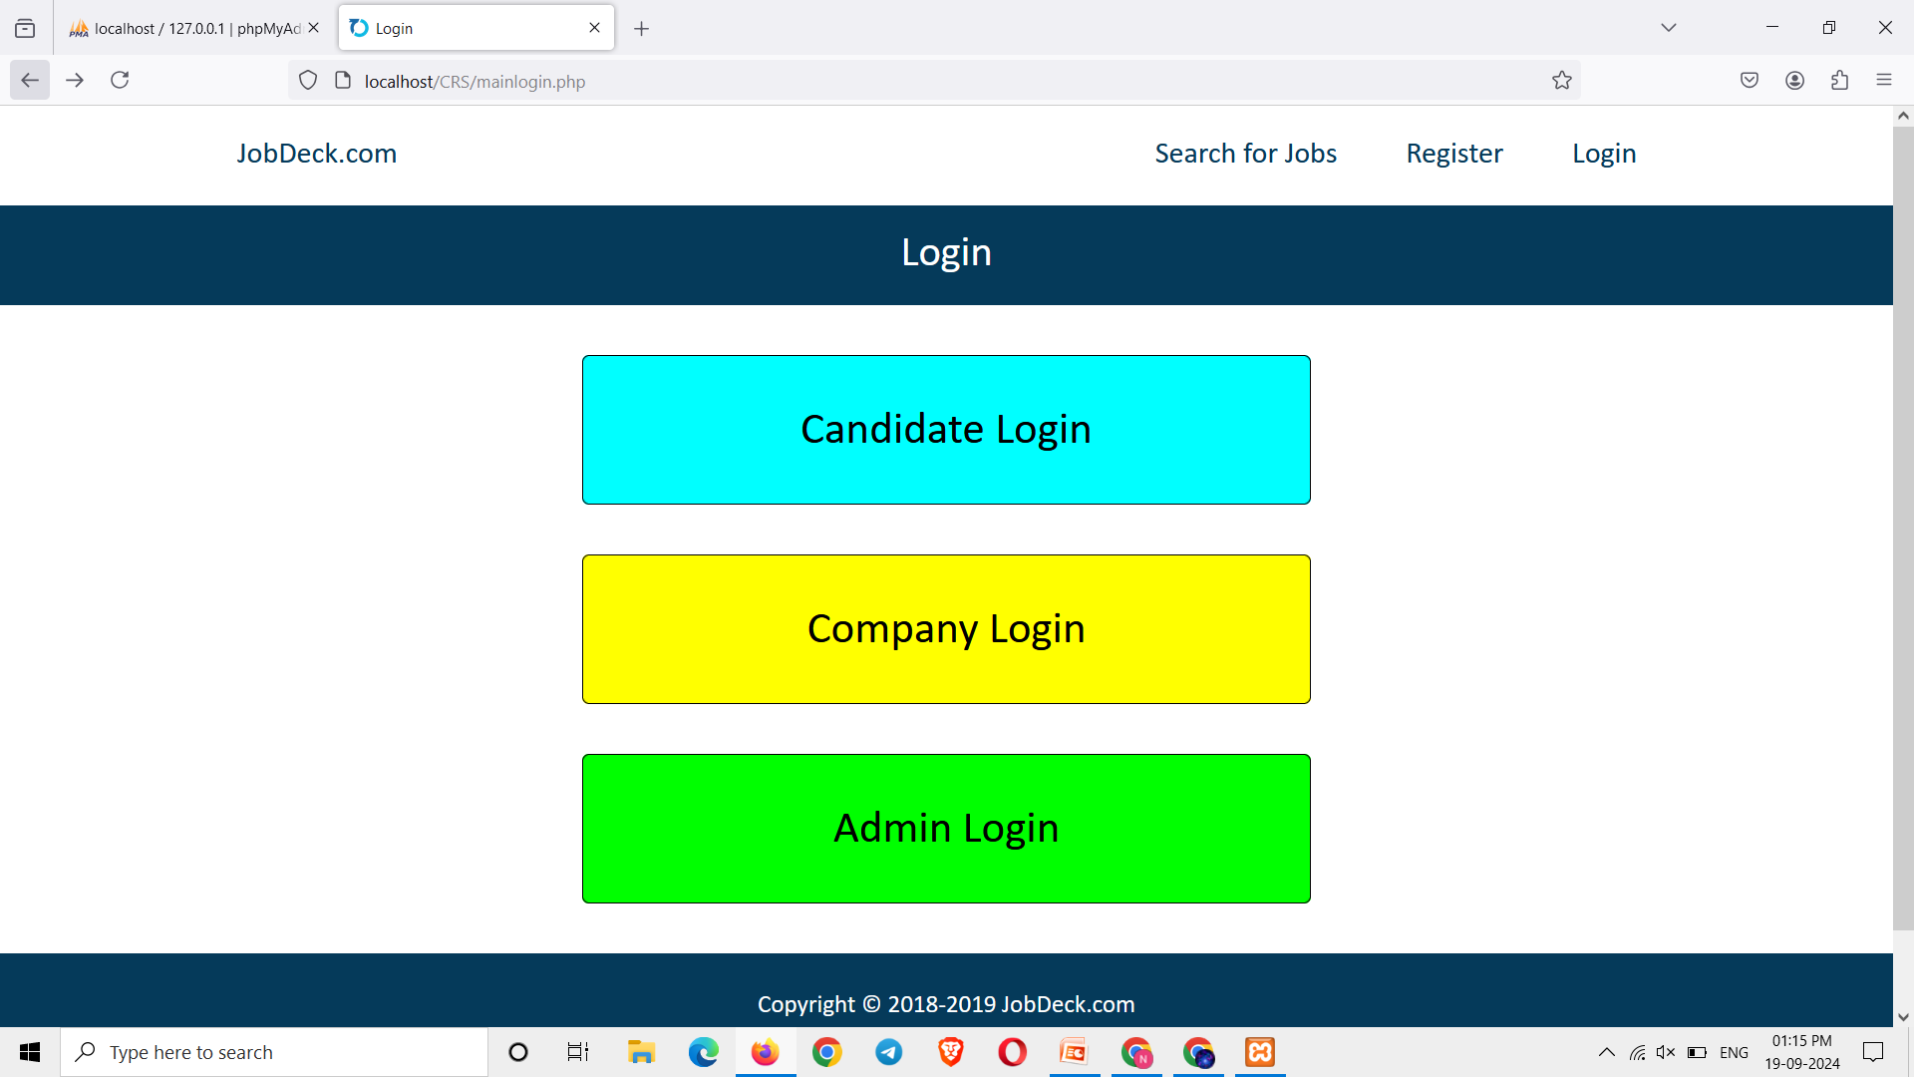
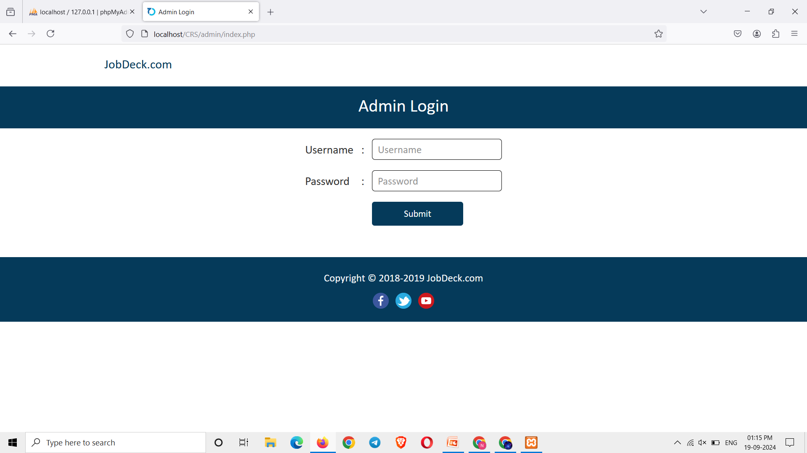

Slide 15
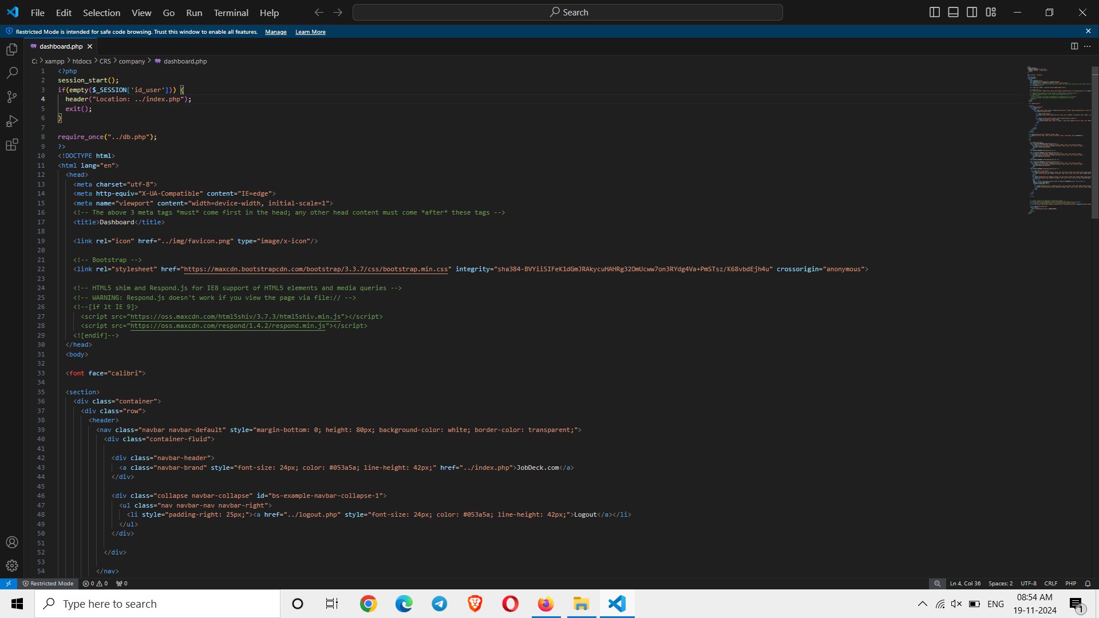
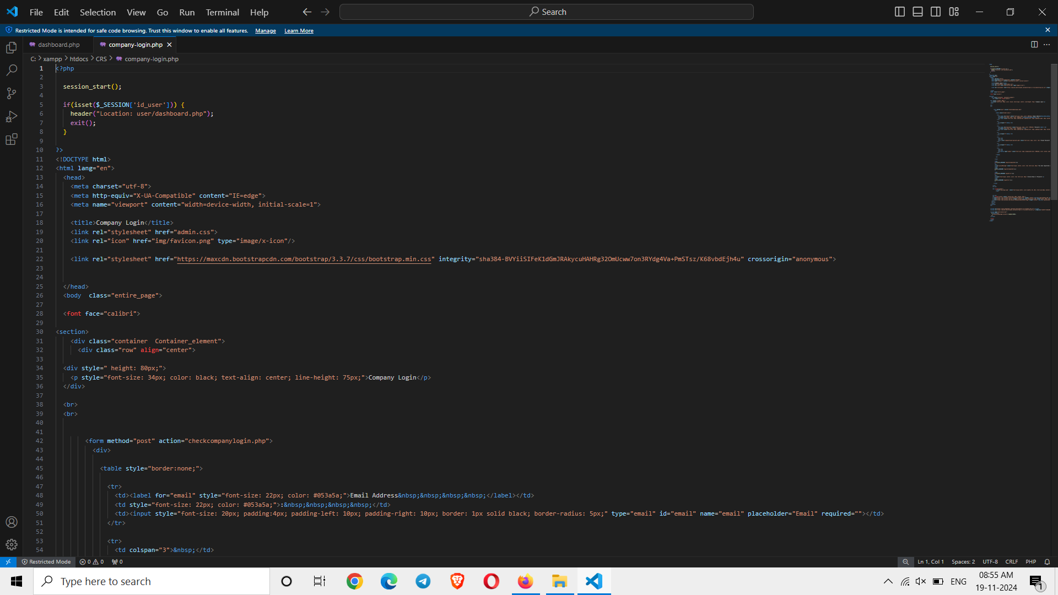

Slide 16
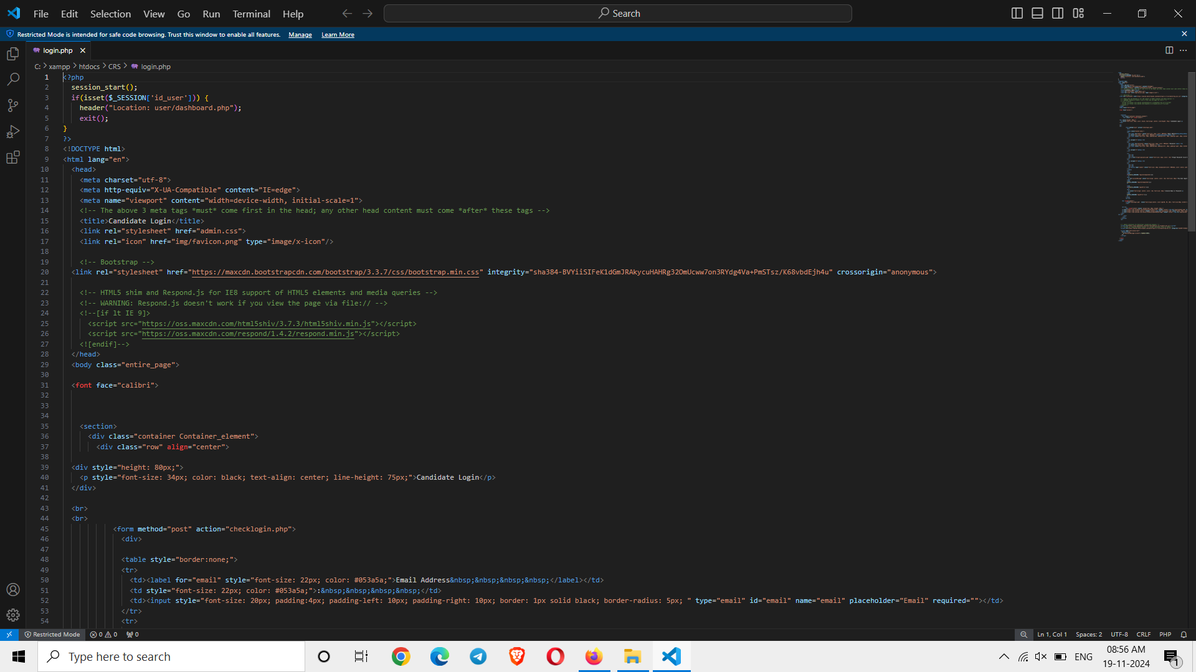
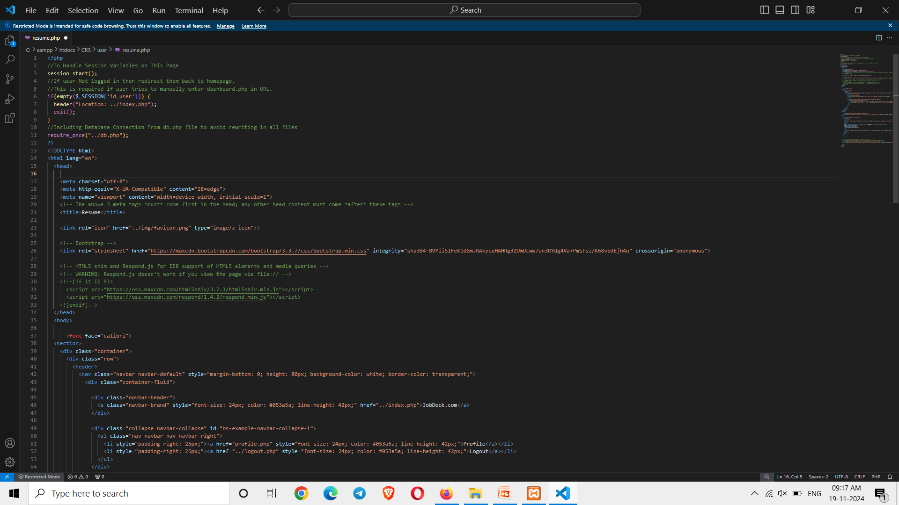

Slide 17
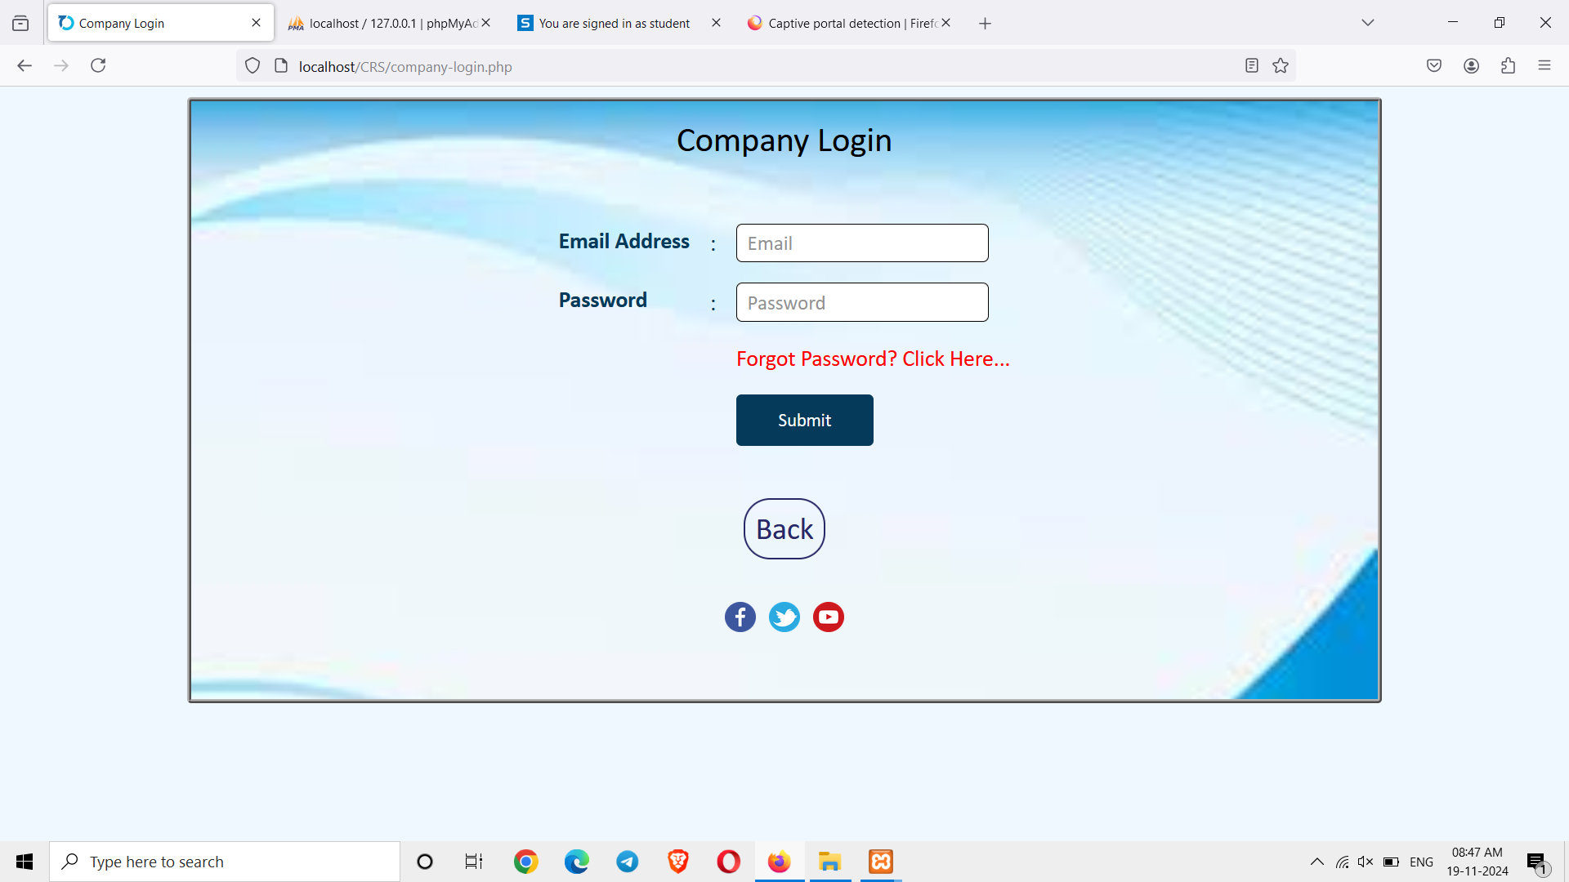
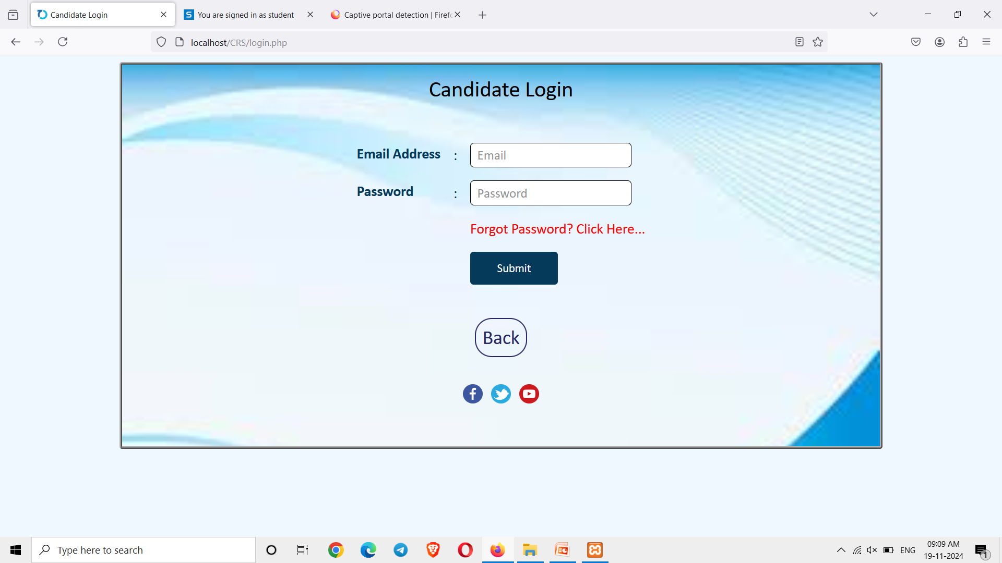
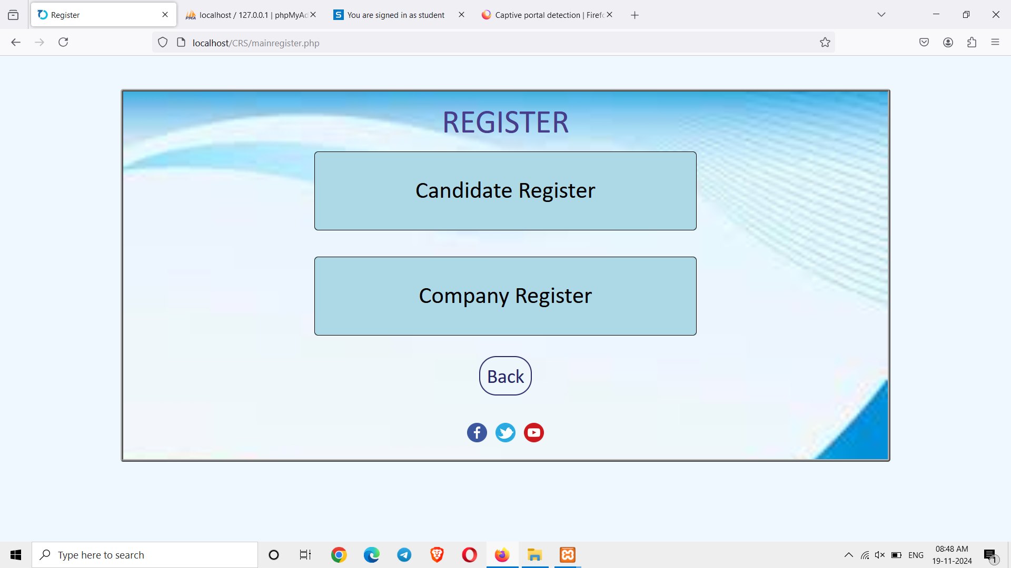
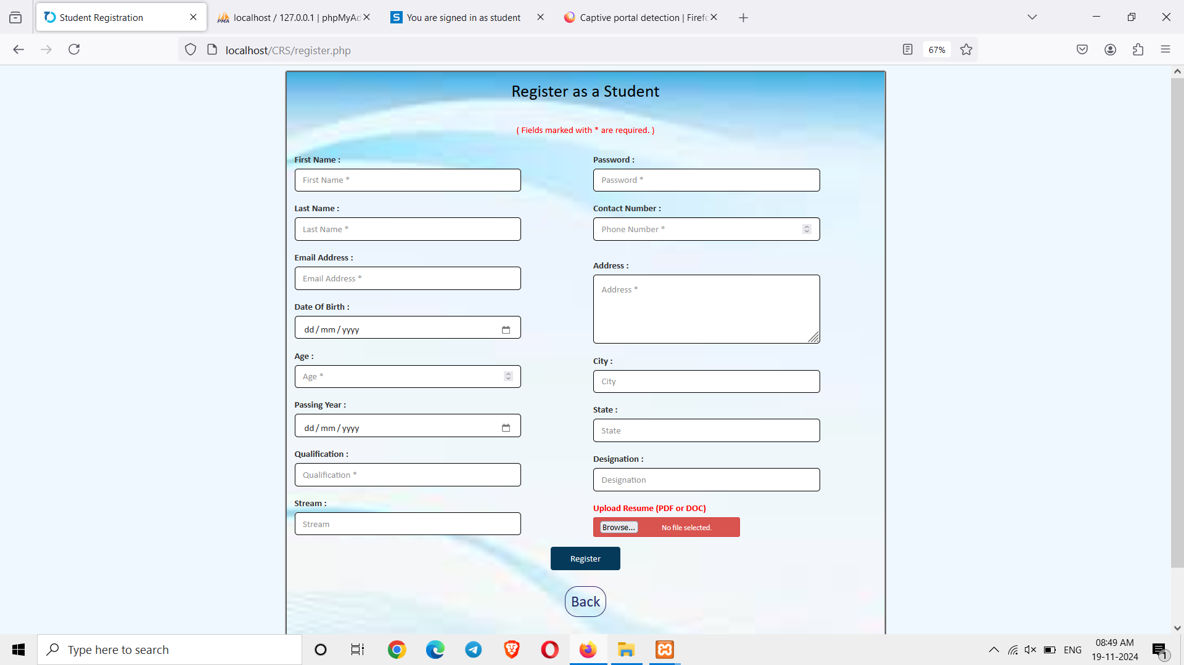

Slide 18
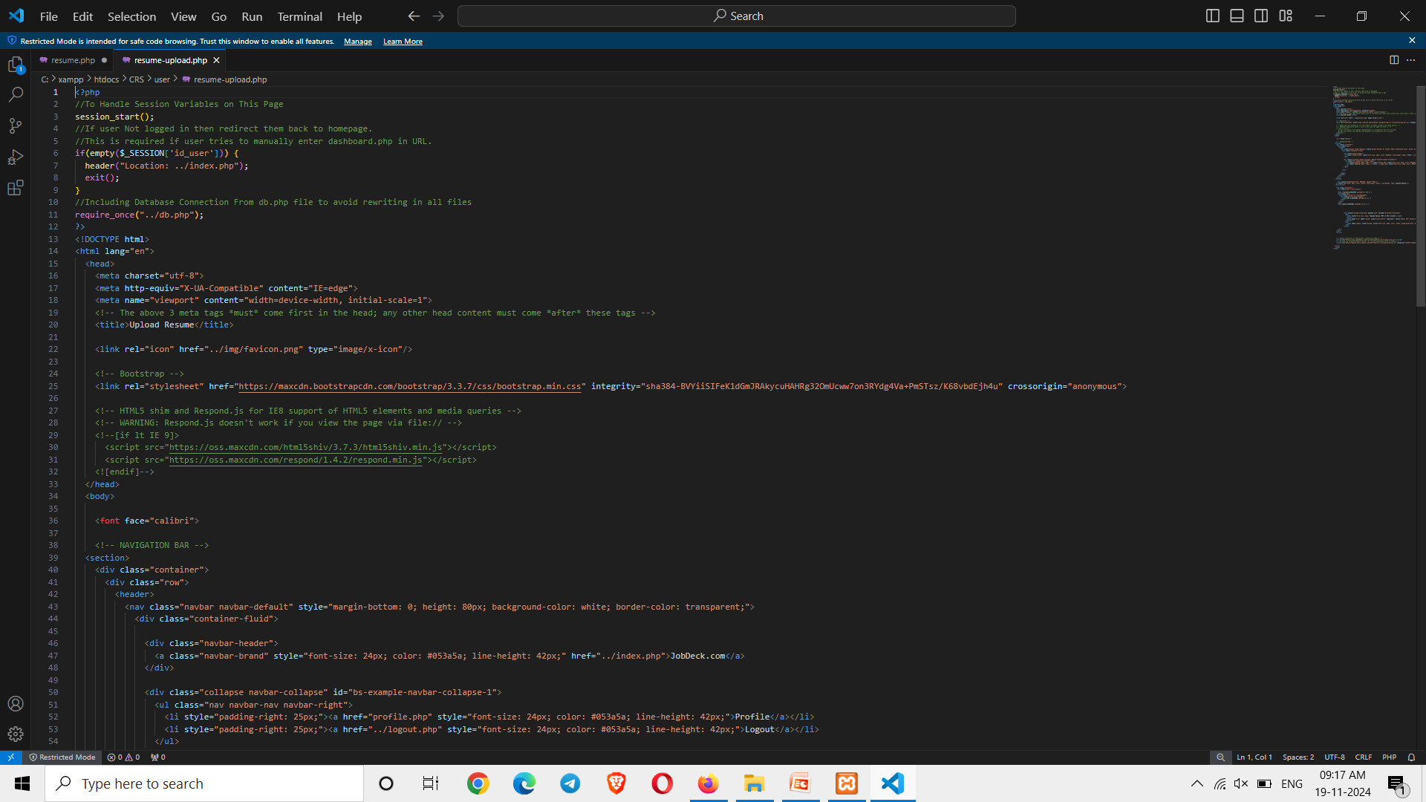

Slide 19
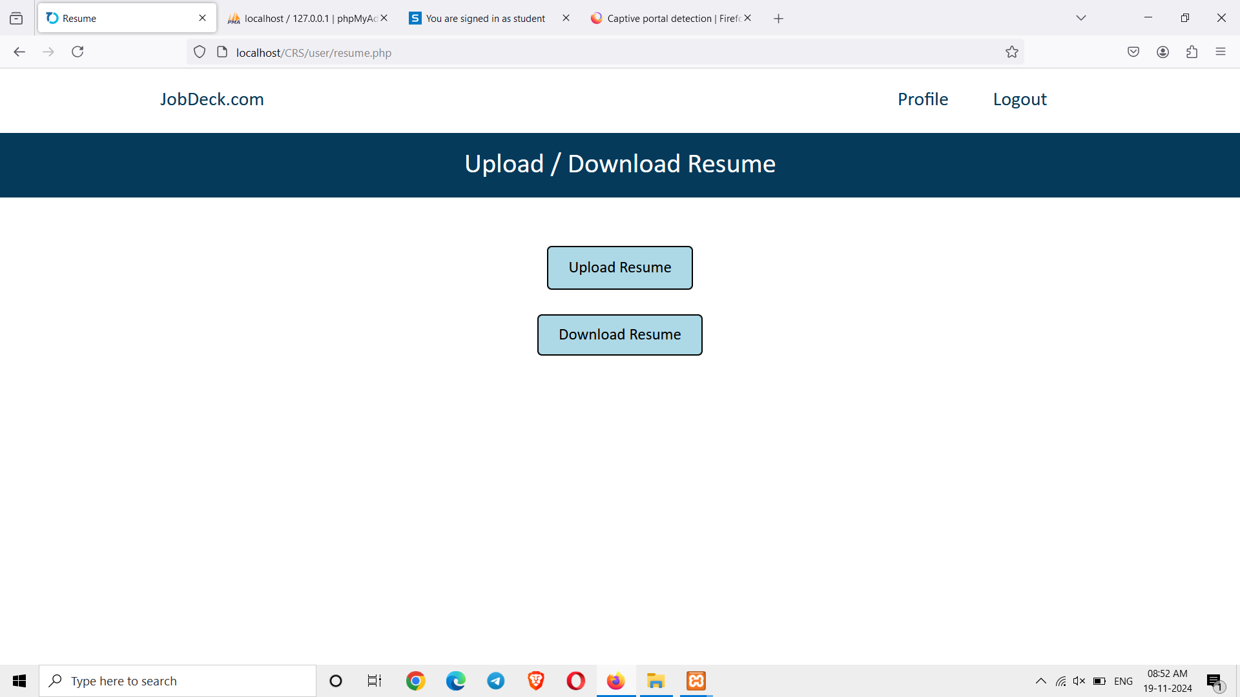
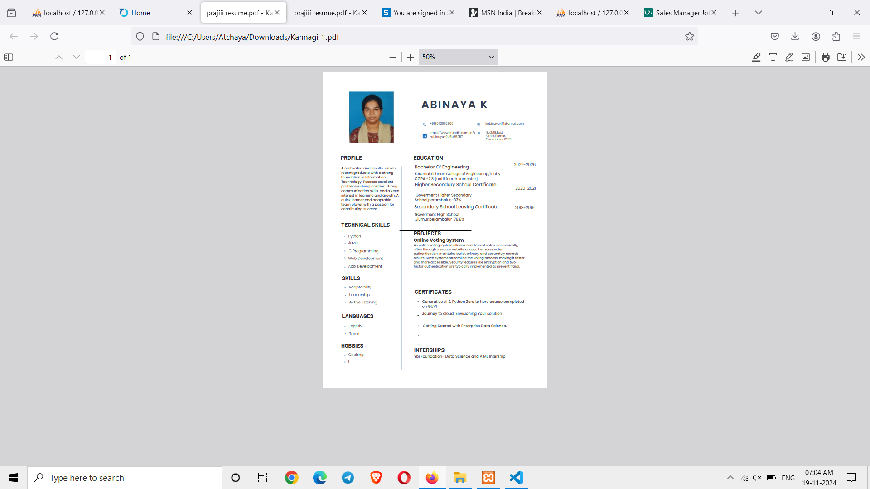
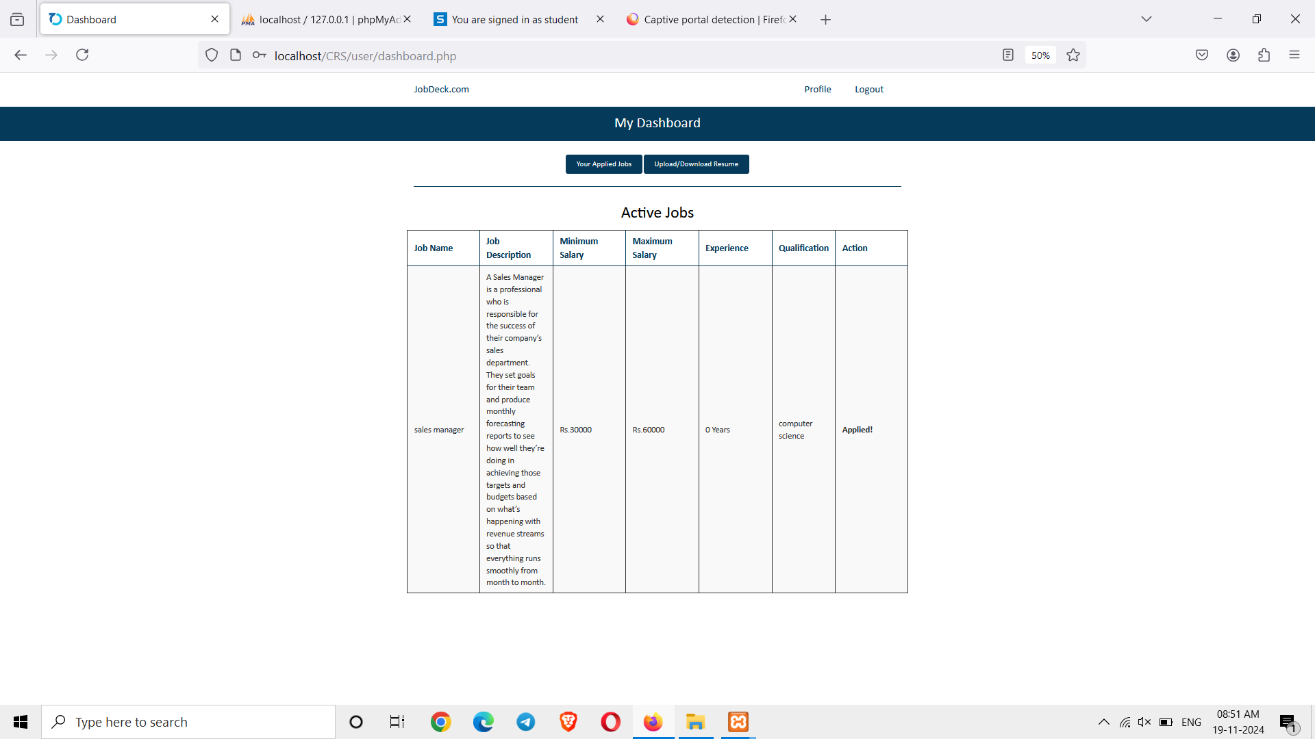
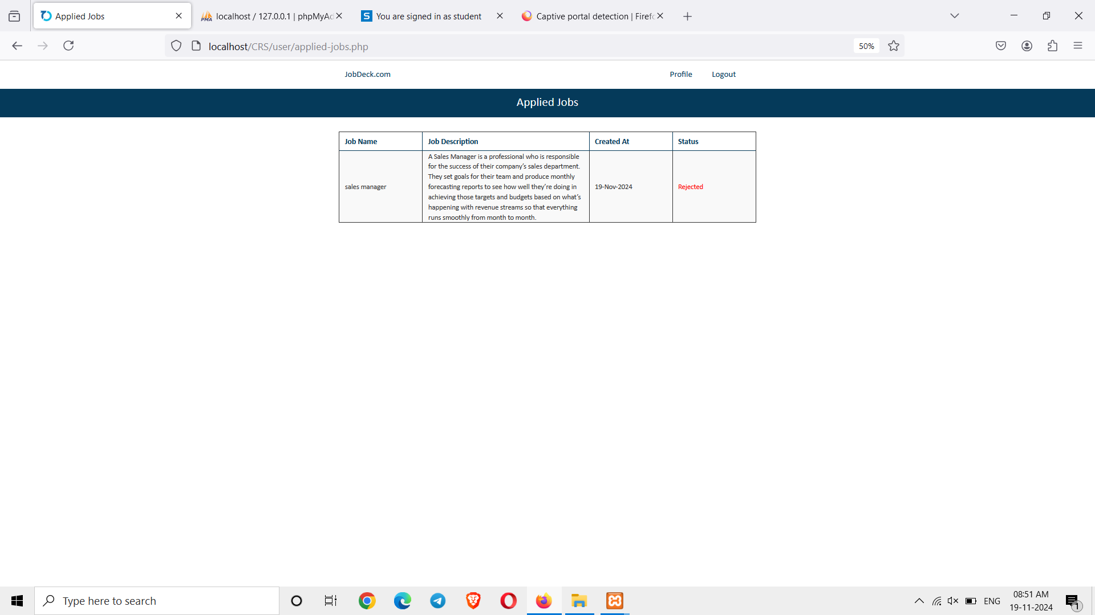

Slide 20
The Campus Recruitment System streamlined the recruitment process by automating tasks, enhancing data security, and improving communication. Despite initial challenges like data integration and user training, the system proved efficient, user-friendly, and scalable. It reduced manual effort and increased transparency, with potential for further enhancements like AI matching and video interviews.

Slide 21
CONCLUSION
The Campus Recruitment System simplifies and automates the recruitment process, improving efficiency for both students and recruiters. It centralizes tasks like job postings, registration, and interview scheduling, leading to smoother communication and better placement outcomes. The system provides a solid foundation for future enhancements.

Slide 22
THANK YOU

